Slide 1
CS492 - Operating Systems Threads in Linux
Georgios Portokalidis & Jun Xu
MOS 10.3.1, 10.3.2, 10.3.3, LDD 2
Slides credit: Antonio Barbalace

Slide 2
Implementation of Threads in Linux
Threads are implemented in kernel (not user) space
Process and thread tables are in kernel
Linux uniformly handles processes and threads
Process and thread tables are unified into a single data structure
Same applies to PCB and TCB
Processes and threads are tasks
The same task_struct represents a process or a thread
A single threaded process has one task_struct
A multi threaded process has one task_struct per thread
Notes:
Linux uses the task structure to represent any execution context
Tasks are organized in a linked list or in a tree
For each process, a process descriptor of type task struct is resident in memory at all times. It contains vital information needed for the kernel’s management of all processes, including scheduling parameters, lists of open-file descriptors, and so on. The process descriptor along with memory for the kernel-mode stack for the process are created upon process creation.

Slide 3
task_struct (3)
Kernel code can refer to the current task by using the macro current
Defined in <asm/current.h>
Yields a pointer to a struct task_struct
The current pointer refers to the task that is currently executing in user space
printk(KERN_INFO “Task \"%s\" (pid %i) on CPU %d\n",
current->comm, current->pid, current->on_cpu);

Slide 4
pthread_create()
pthread_create()
Creates a new thread in a process
There is no pthread_create() syscall
Thread creation is done by clone() syscall

Slide 5
clone() Revisited
https://linux.die.net/man/2/clone
child_id = clone(function, stack_ptr,
sharing_flags, arg);
Introduced in Linux in 2000
Linux assigns TID for each thread
To check the TID use the gettid() syscall
Warning! Glibc doesn’t provide a wrapper for this call
tid = syscall(__NR_gettid);
Notes:
At very high level you can think about clone as the equivalent of fork but for thread, in the sense that it creates a new thread such as fork creates a new process
However, remember that fork doesn’t have any argument, while clone has multiple arguments, DISCUSS THE ARGUMENTS

Slide 6
clone() Revisited (2)
Clone is special
Blurs the distinction between process and thread creation
It creates processes or threads
Processes and threads are both tasks in Linux
Creates a new task
either in the current process (new thread)
Shares the address space with the existing threads
or in a new process (new process)
The address space is not shared
Linux assigns PID and TID for each thread
Assigns PID based on the clone’s parameters
Notes:
The call creates a new thread, either in the current process or in a new process, depending
on sharing flags. If the new thread is in the current process, it shares the
address space with the existing threads, and every subsequent write to any byte in
the address space by any thread is immediately visible to all the other threads in
the process. On the other hand, if the address space is not shared, then the new
thread gets an exact copy of the address space, but subsequent writes by the new
thread are not visible to the old ones

Slide 7
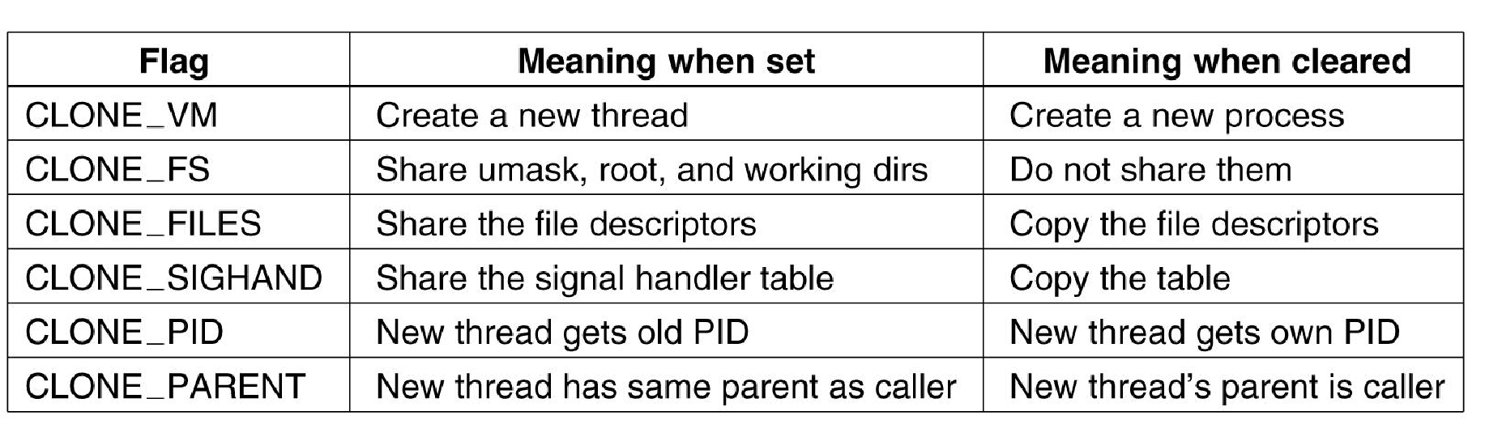
clone() Revisited (3)
Bits in the sharing_flags bitmap (MOS Figure 10-9)

Slide 8
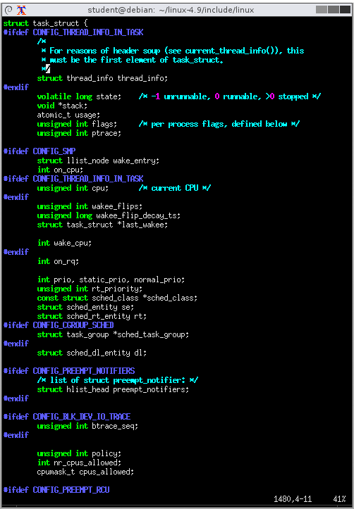
task_struct Revisited
include/linux/sched.h:1475
Interesting fields
long state
void *stack
uint flags
int on_cpu
int prio, static_prio, normal_prio
cpumask_t cpus_allowed
struct mm_struct *mm
pid_t pid, tgid
struct task_struct *parent
u64 start_time
char comm[TASK_COMM_LEN]
Program executable

